Slide 1
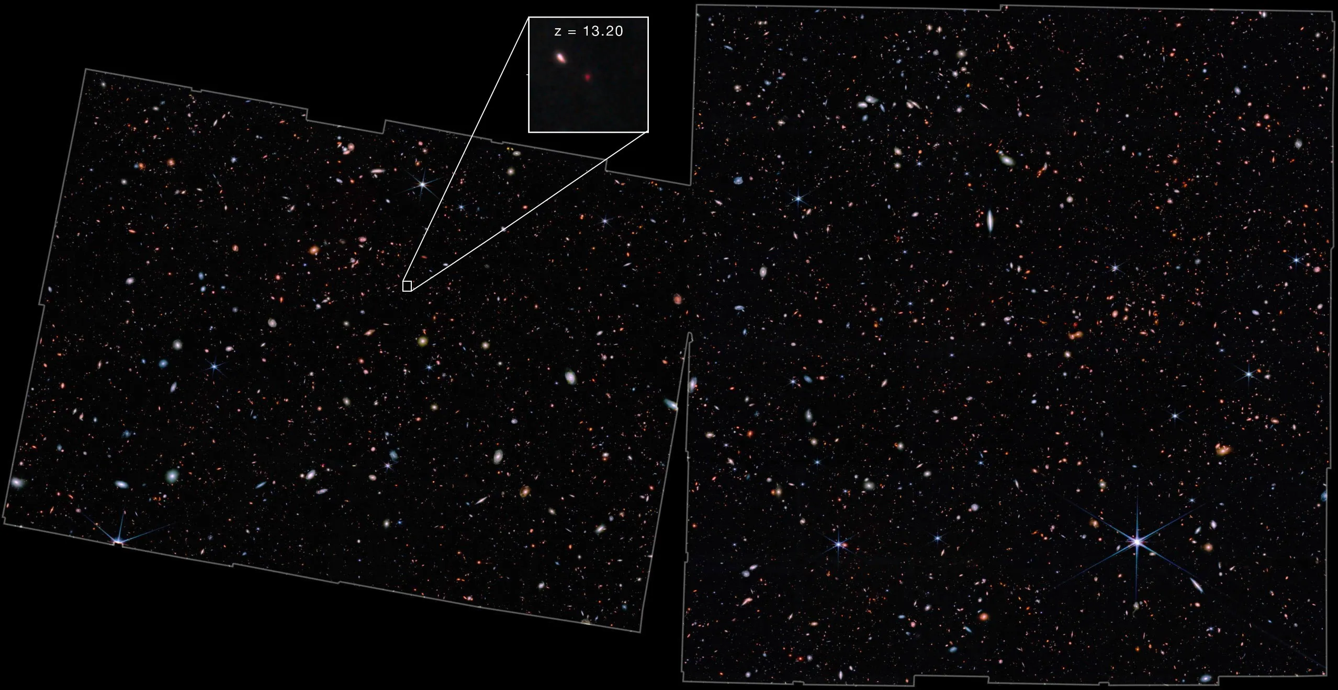
Hunting High Redshift Galaxies with JWST
Blythe Fernandes
Supervisor: Prof. Ross McLure
1 Arcmin
(NASA, ESA, CSA, M. Zamani (ESA/Webb))
Notes:
(Introduce yourself)
As you can see, I will be talking about the galaxies that I had been studying for the last year with JWST
Left side of Cover Slide:
JADES field
I had been working
Furthest Galaxy detected with JWST is at z = 13.2

Slide 2
Outline
Motivation & Aim
Epoch of Comic Reionisation
Emission lines
Calibrations
Data
Noise
Built the Catalogue
Error on the Flux
Gathering Flux Data
Getting Results
Redshifts
Equivalent Width
UV Spectral Slope
Notes:
I will begin the presentation
With a Motivation
Epoch of Comic Reionisation
Emission examined in this project
Talk about the method of the project
Perform calibrations
With Calibrations, produce a catalogue
With flux and errors
Getting results:
For redshifts
Which are then used to get other properties

Slide 3
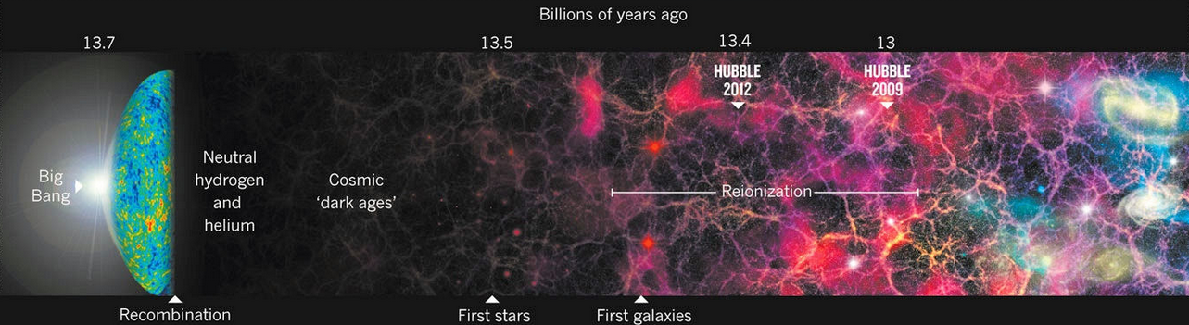
Cosmic Reionisation
(R. Cowen., 2013)
z ≈10
We want to better understand the Epoch of Cosmic Reionisation
Need to look further back in time
Probe high redshifts
Faint galaxies
HST could observe to z ≈ 10
Can observe further with JWST
Notes:
Motivation and Background:
Don’t exactly know what the early universe looked like
Event in time in the early universe
-Period of Time - Neutral Hydrogen reionised
Due to UV radiation from 1st stars & galaxies
We have a good understanding for when Cosmic Reionisation ended
But want to get a sense of when it roughly started
For this:
we need look into the distant past.
Therefore; probe high redshifts and look for faint galaxies
With the HST:
Until about z = 10 could be probed
But want to understand:
The period when First Galaxies were formed
JWST is brilliant
It can go to higher redshifts; Like I showed at the start

Slide 4
Aim
To better understand the universe during the epoch of cosmic reionisation
To understand how our current universe came to be
Notes:
The aims..

Slide 5
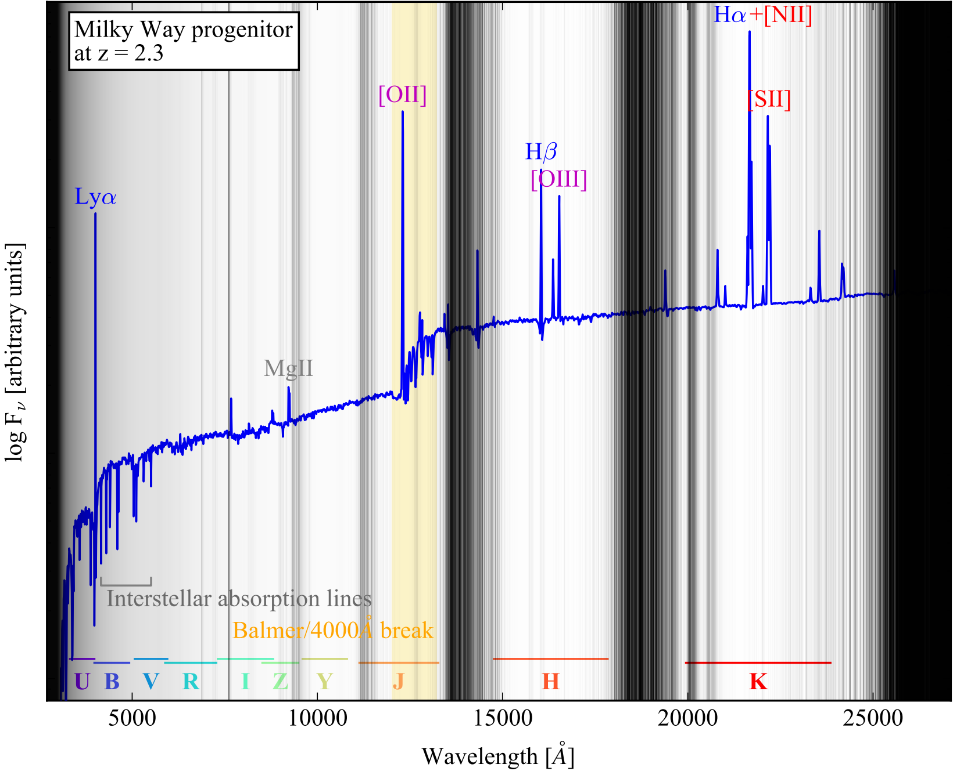
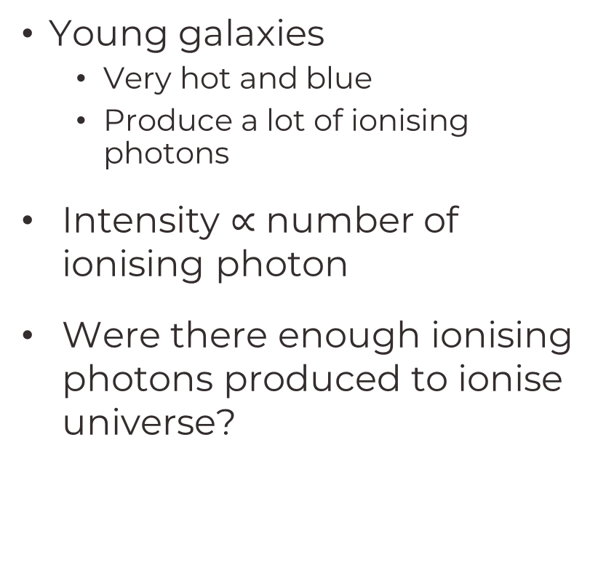
Emission Lines
(Förster Schreiber, et al. 2020)
O[III] (5007 Å)
Young galaxies
Very hot and blue
Produce a lot of ionising photons
Intensity $\text{∝}$ number of ionising photon
Were there enough ionising photons produced to ionise universe?
Notes:
2 of the brightest emission lines are the O[III] and H-alpha
Intensity of Emission is prop to No. of Ionising Photons
Image on the right is an SED of a SFG
Black lines represent emission lines that can’t be seen from the ground.

Slide 6
Emission Lines
(Förster Schreiber, et al. 2020)
Hα (6563 Å)
Indicator - Star Formation Rate
Young stars born
Ionise Gas
Gas starts to recombine
Recombination produces Hydrogen
Notes:
- Second one: H-alpha

Slide 7
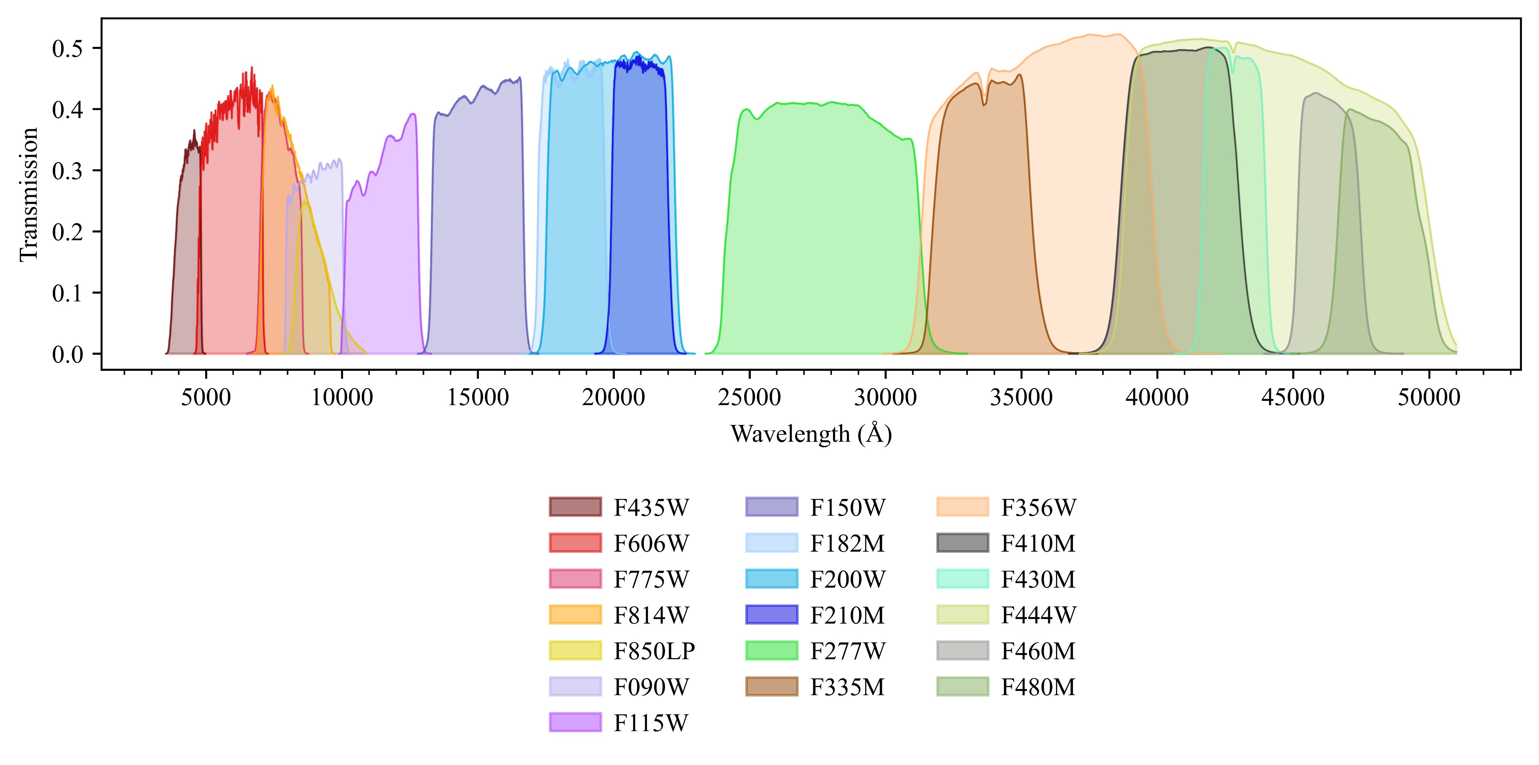
Filter Transmission Curves
HST ACS
(Hubble Space Telescope – Advanced Camera for Surveys)

Slide 8
Filter Transmission Curves
NIRCam - Short Wavelength
(Near InfraRed Camera)

Slide 9
Filter Transmission Curves
NIRCam - Long Wavelength
(Near InfraRed Camera)

Slide 10
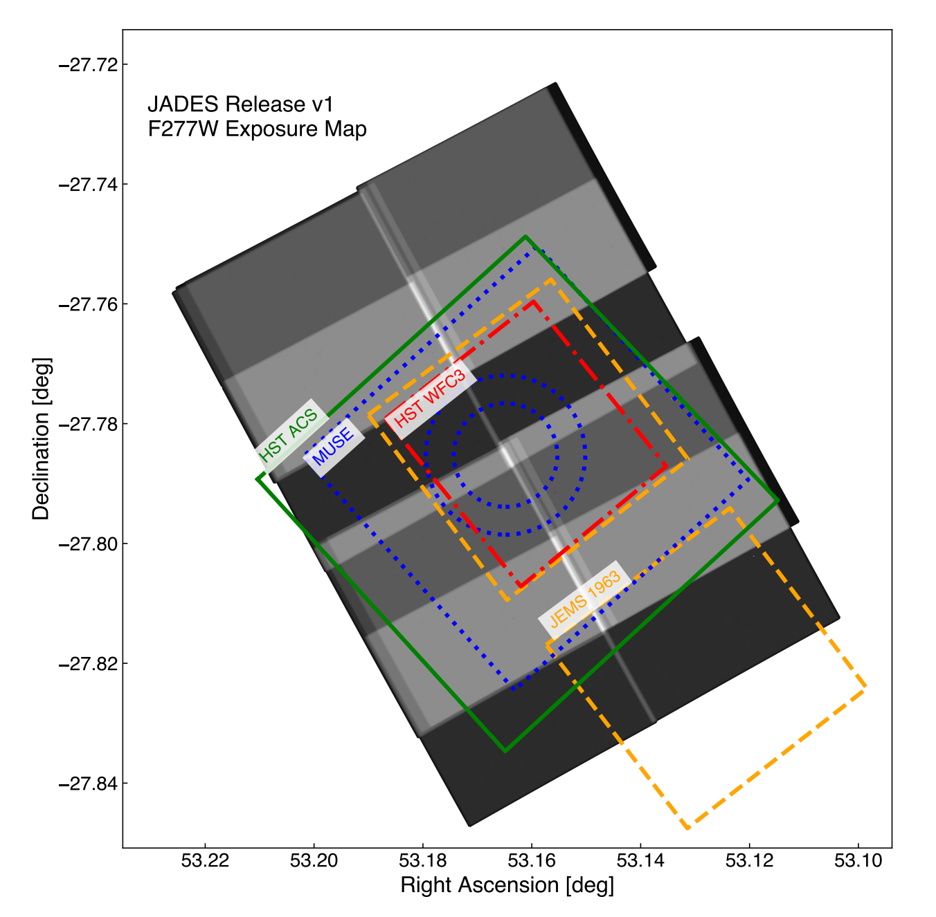
Chosen Field of View
(Rieke et al., 2023)
Studied extensively for
Photometry
Spectroscopy
Analysis done with data from
JADES
HST Ultra Deep Field (in Green)
Notes:
Has been studied extensively for
Photometry
Spectroscopy
Analysis done with data
NirCam – Short and Long
HST ACS
The plot:
Shows field of previous surveys in comparison to the JADES survey
HST sits within the chosen field
Used for analysis
Good distribution of Wavelengths to study with HST data
55s
(Popularily known as:
GOODS – South)

Slide 11
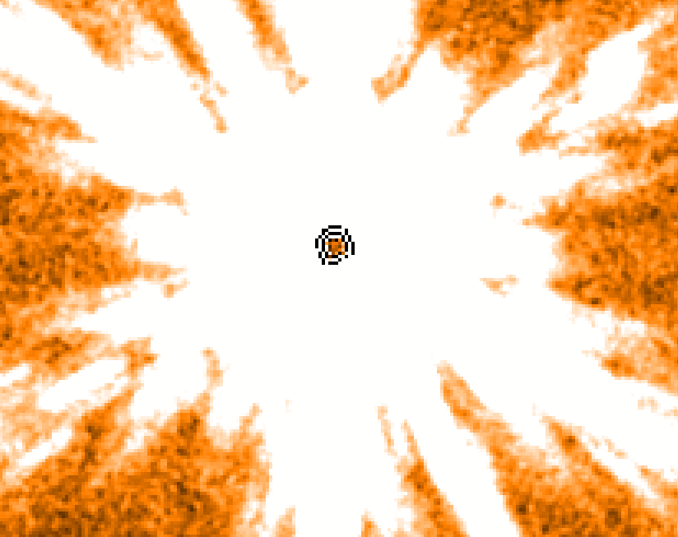
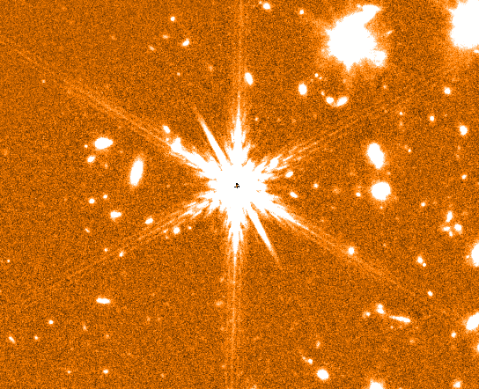
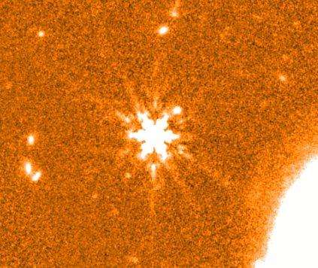
Data Calibration
[Taken from JADES Survey]
Choose a Star for Aperture Correction
Isolated
Unsaturated in all filters
Curve of Growth:
Collecting flux
Increasing aperture radius
Find best aperture size
At optimal S/N
[Taken from JADES Survey]
Notes:
First point of business:
Perform a PSF Homogenisation
Choose a Star for Aperture Correction
Has to Point Source –
Look for Diffraction Spikes
Galaxies would be more rounded
Light is coming from multiple sources
Isolated
Unsaturated in all filters
No Flux Spillage
Now produce Curve of Growth:
With the same single star
Increase radius - 0.05 step
Determine flux acceptance aperture
We said 70% (Next Slide)
PUT FIGURE LABELS
1:21s

Slide 12
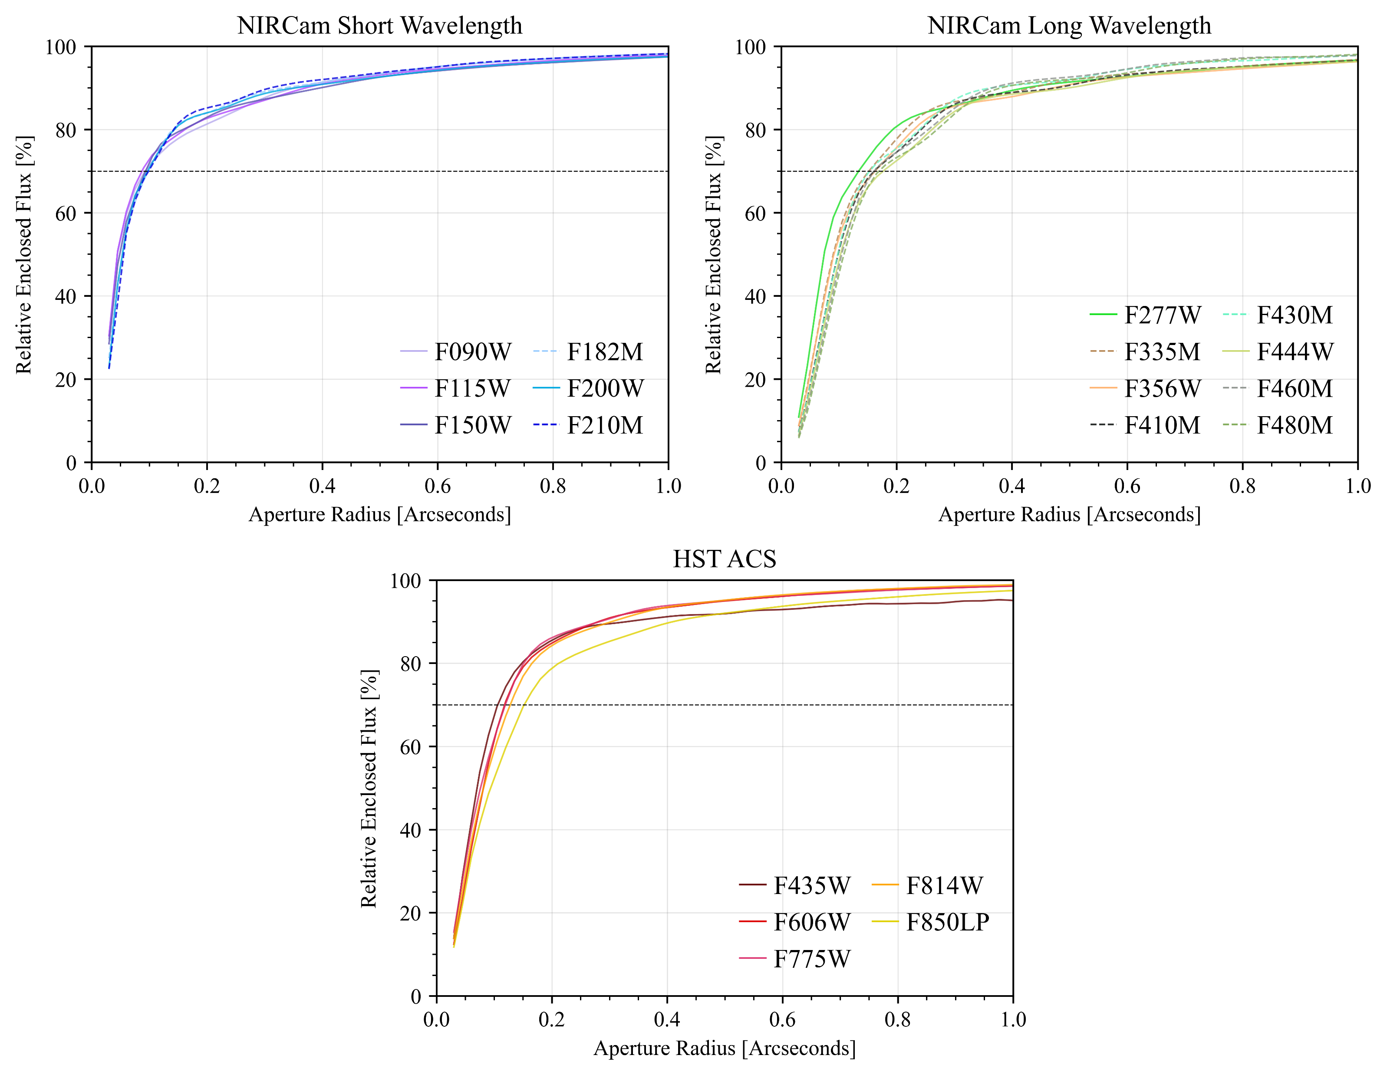
Notes:
Curve of Growth:
Exponential Growth
Meaning Object Flux
Flattens out at the end
All object flux collected
Collecting sky noise in aperture
70% corresponds
But some of the curves are not all at 70%
Need to get the curves to be at 70%
Up or Down
For this:
Convolution is needed
Use F444W because it is
54s

Slide 13
Data Calibration
[Taken from JADES Survey]
Choose a Star for Aperture Correction
Isolated
Unsaturated in all filters
Curve of Growth:
Collecting flux
Increasing aperture radius
Find best aperture size
At optimal S/N
Convolve the Data
To the filter with the longest wavelength
[Taken from JADES Survey]
Notes:
Need to add another step called Convolution.
Essentially the data is purposely blurred in the worst resolution that we have
And then

Slide 14
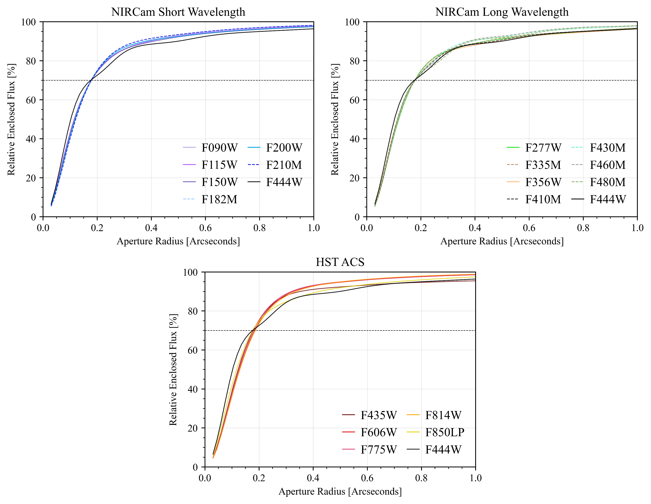
Notes:
Curve of Growth:
Exponential Growth
Meaning Object Flux
Flattens out at the end
All object flux collected
Collecting sky noise in aperture
70% corresponds
But some of the curves are not all at 70%
Need to get the curves to be at 70%
Up or Down
For this:
Convolution is needed
54s

Slide 15
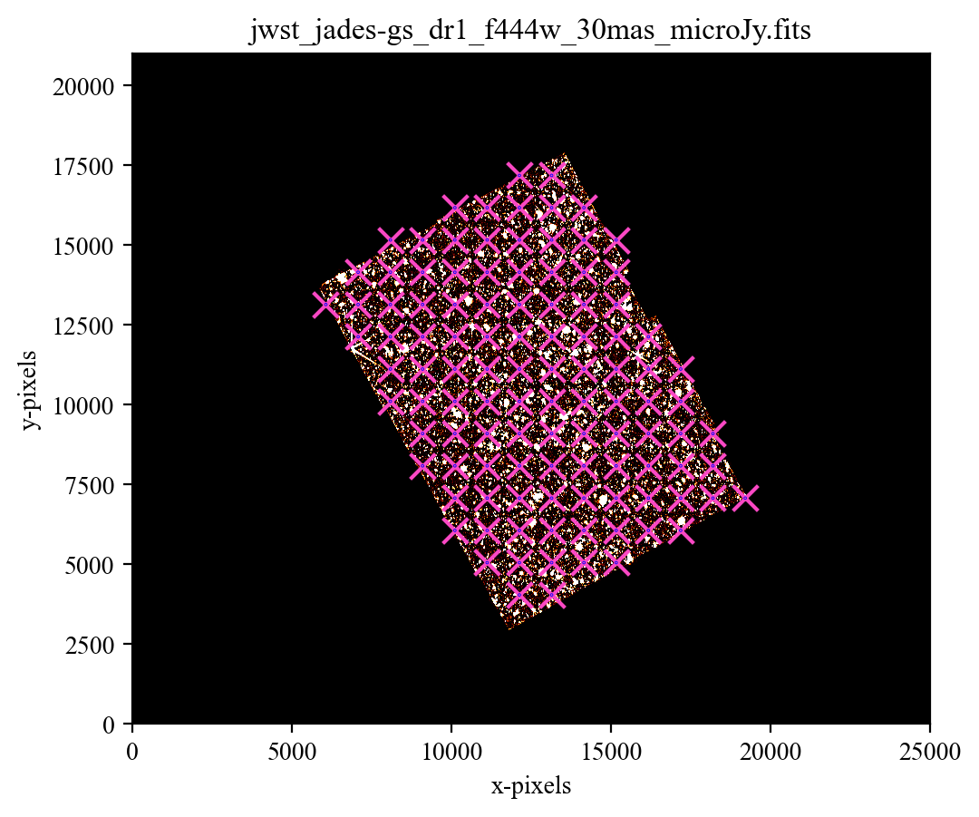
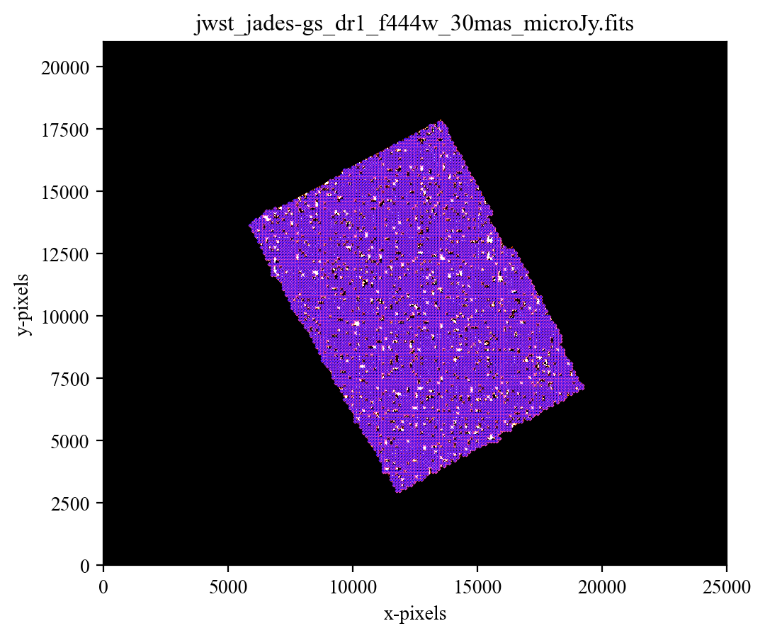
Noise Calibration
Gathered Sky background noise
Use Aperture Grid
Remove any apertures on objects
Collect flux noise
Noise should be a Gaussian distribution
Centred at 0
Notes:
Second Calibration:
To understand how sensitive the images are
This is done with SEP which is based on the software Source Extractor

Slide 16
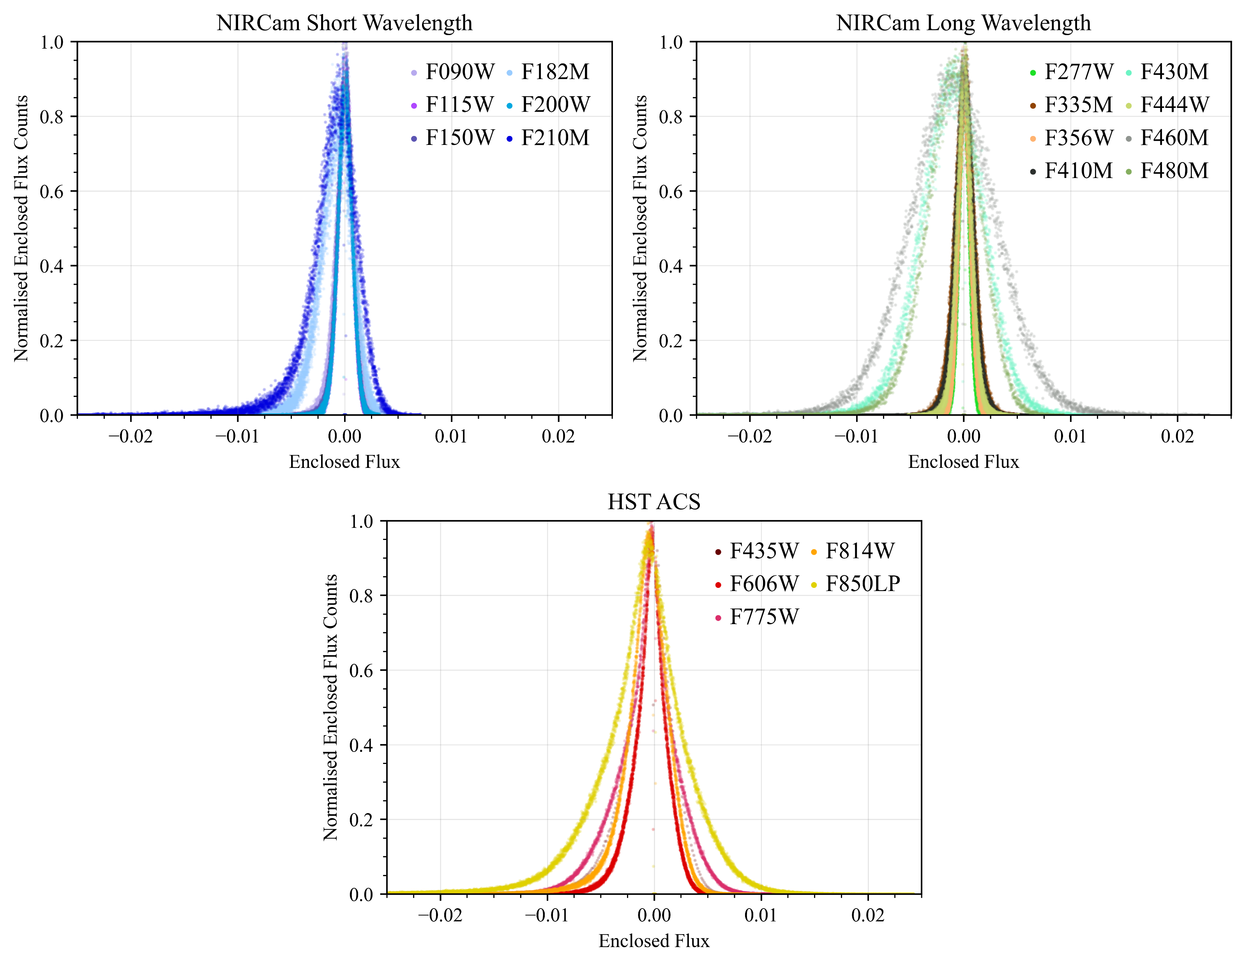
Notes:
There is a sharp peak at 0
As we expect noise to fluctuate around 0
There is a elongated tail on the negative end
Due to image artifacts like wisps and ghost
That the code didn’t pick up as objects
With these curve, we can get the widths which would be set as the error of the data

Slide 17
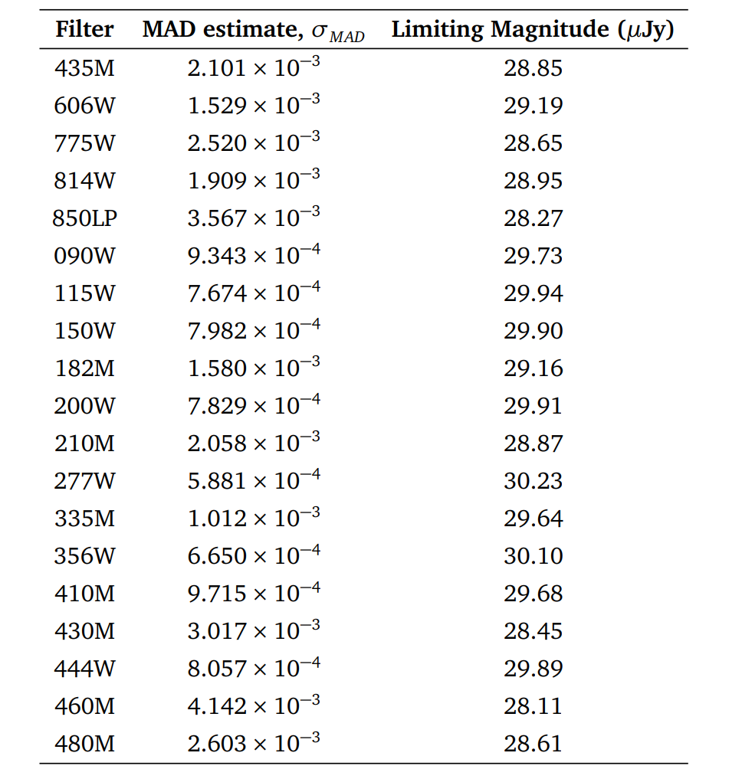
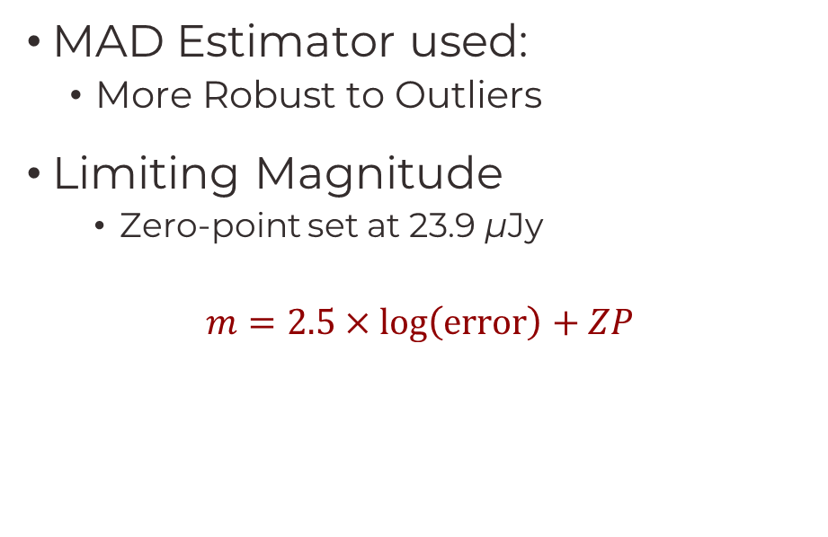
Calibration Results
MAD Estimator used:
More Robust to Outliers
Limiting Magnitude
Zero-point set at 23.9 µJy
$$m=2.5×\log\left(\text{error}\right)+ZP$$
Notes:
Tabled are the sigmas of the curves…
But we can’t use the standard deviation stat to find this.
But I used a MAD estimator known as Median absolute deviation
- More robust to outliers

Slide 18
Building a Catalogue
Catalogue is complied with fluxes and errors
With the calibration values – Catalogue is cut
Sigma Cut: Remove any objects that are noise 5σ cut
Magnitude Cut: Remove any objects considered too bright
Run the Catalogue through a Photometry Redshift software
For redshift estimates

Slide 19
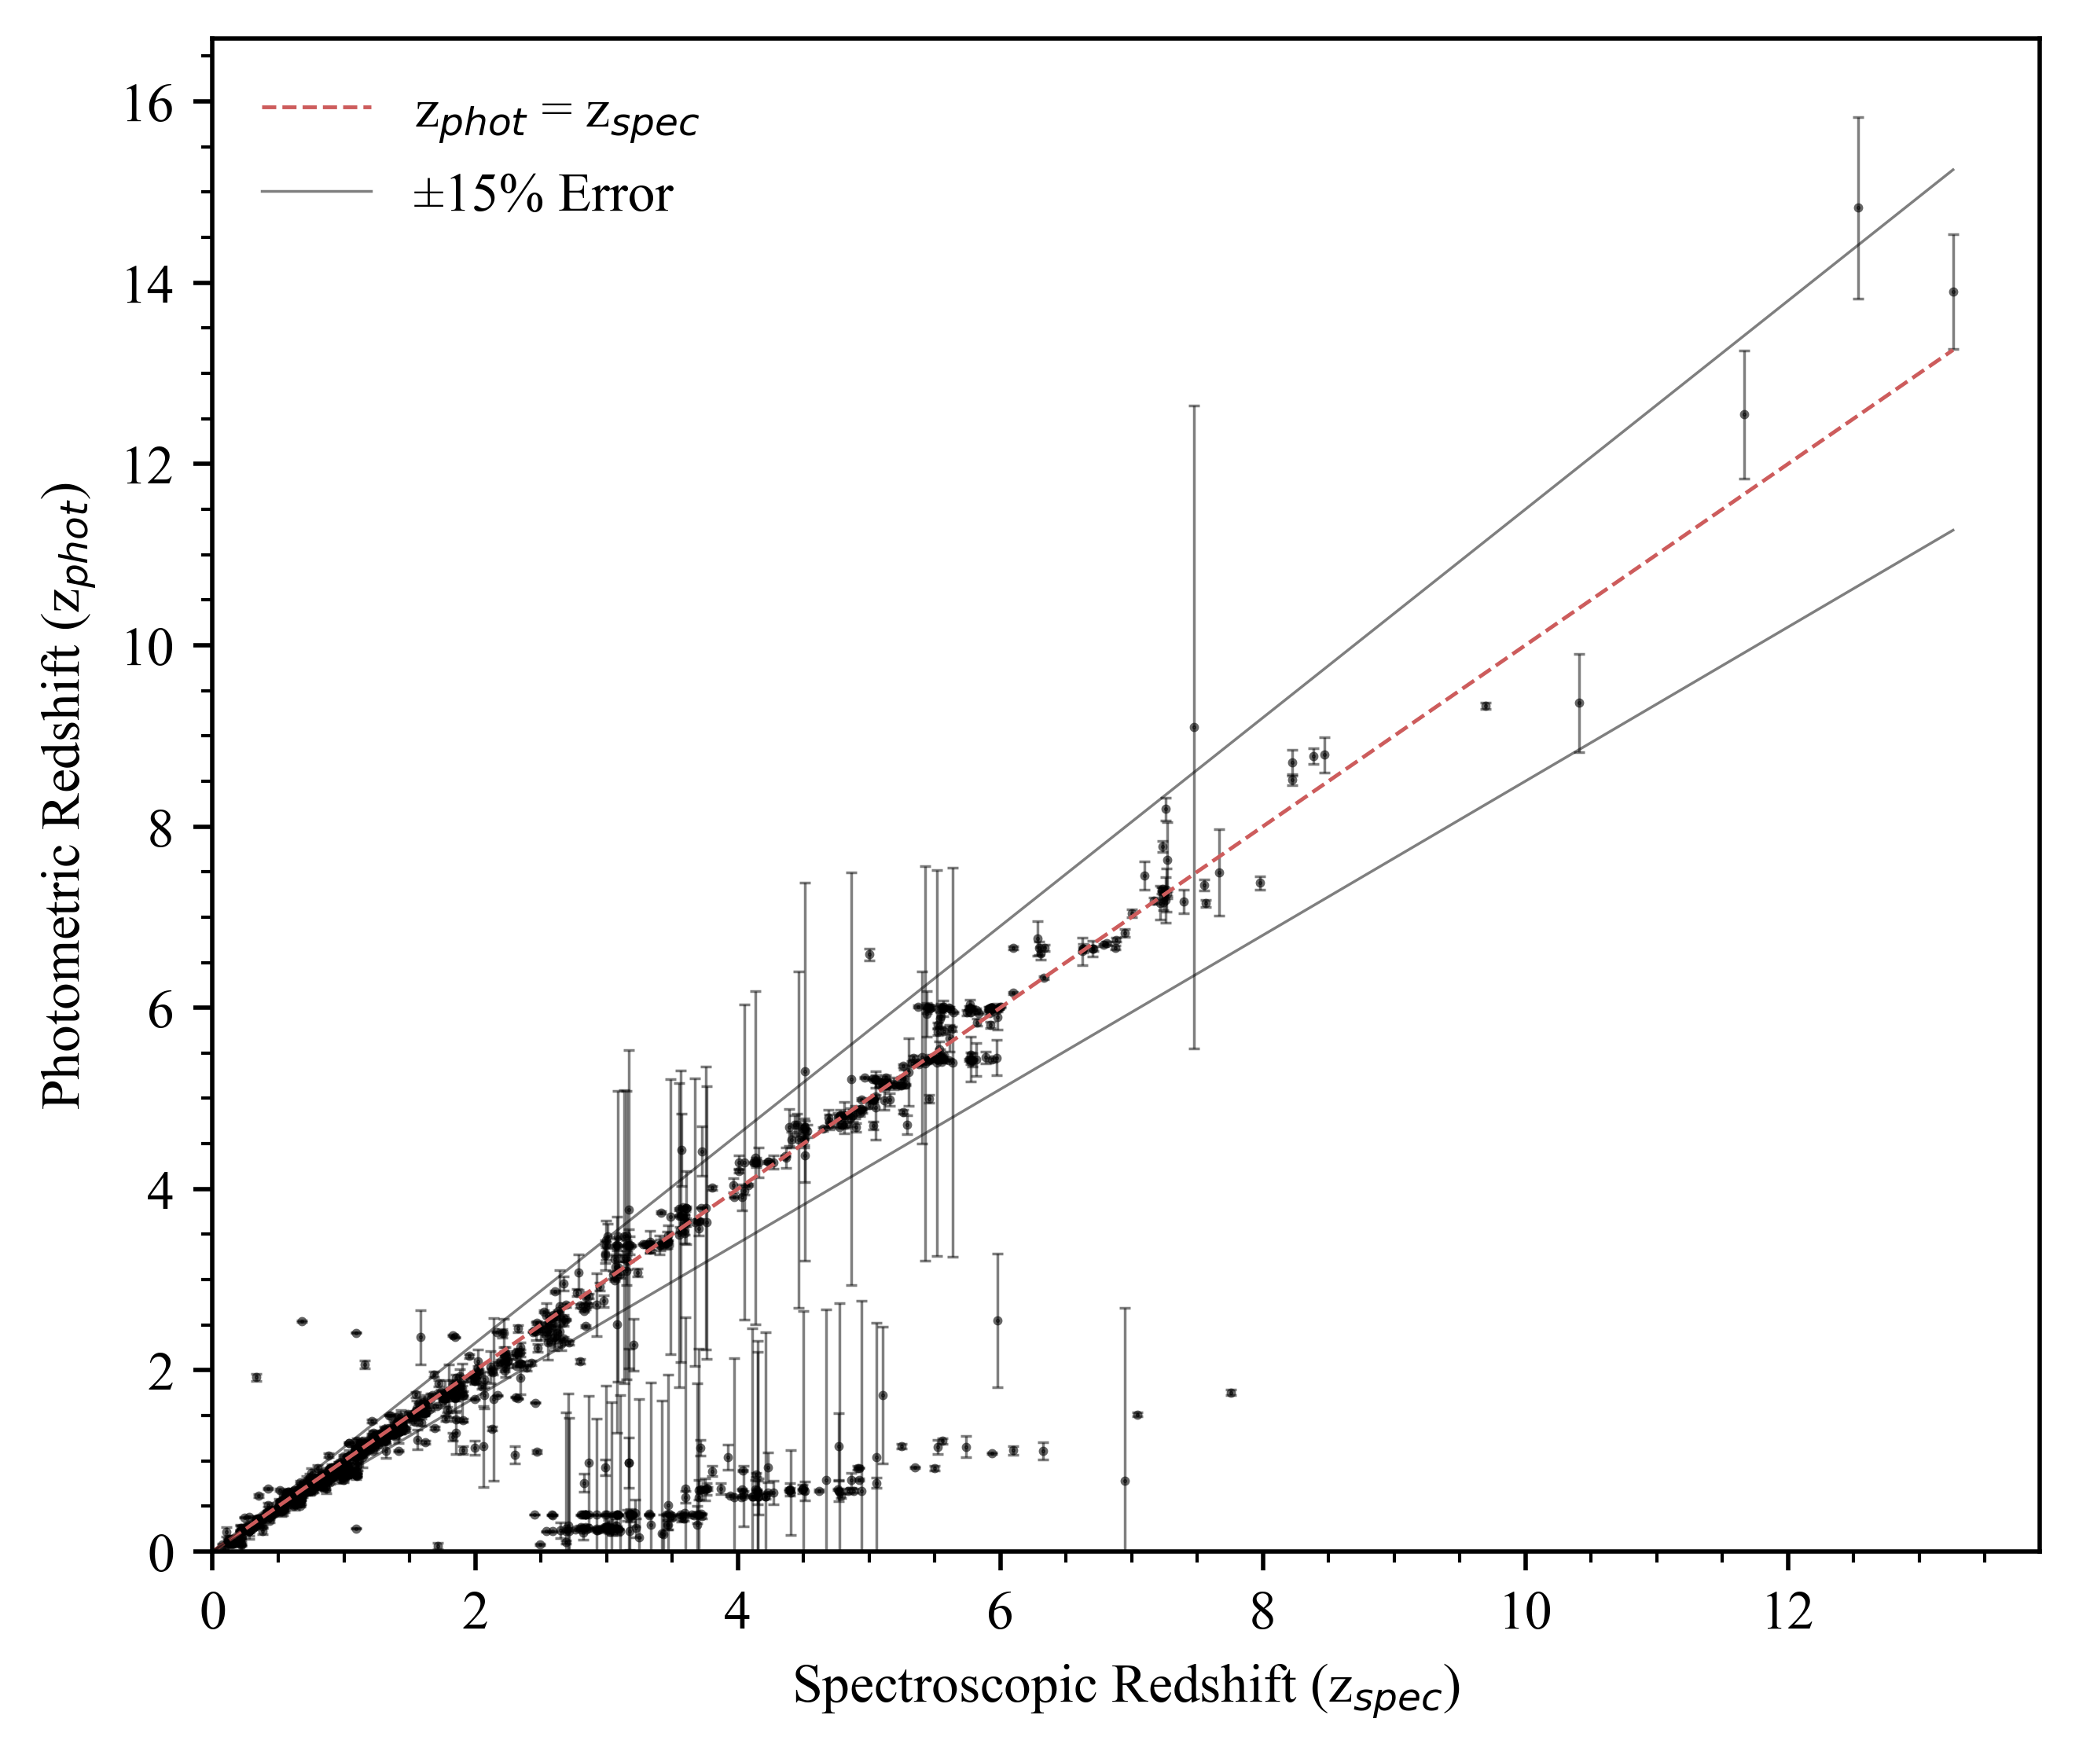

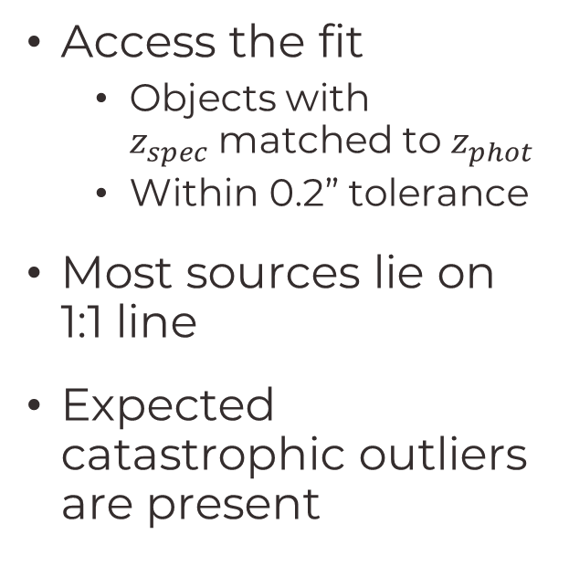
Redshifts
Access the fit
Objects with $z_{spec}$matched to $z_{phot}$
Within 0.2” tolerance
Most sources lie on 1:1 line
Expected catastrophic outliers are present
Notes:
Assess the fit with Literature (Spectroscopic) data
Objects sit on a linear line that goes through 0
Outliers and Catastrophic Outliers
Catastrophic Outliers
Could be that the data comes f

Slide 20
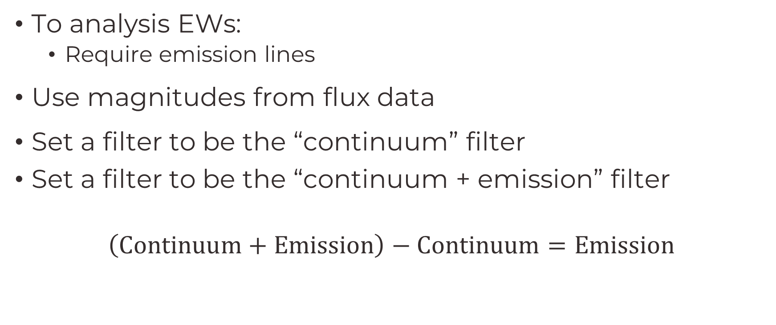
Equivalent Widths (EW)
To analysis EWs:
Require emission lines
Use magnitudes from flux data
Set a filter to be the “continuum” filter
Set a filter to be the “continuum + emission” filter
$$\left(\text{Continuum}+\text{Emission}\right)−\text{Continuum}=\text{Emission}$$
Notes:
To understand EW
We need emission lines
Can be done with the data from

Slide 21
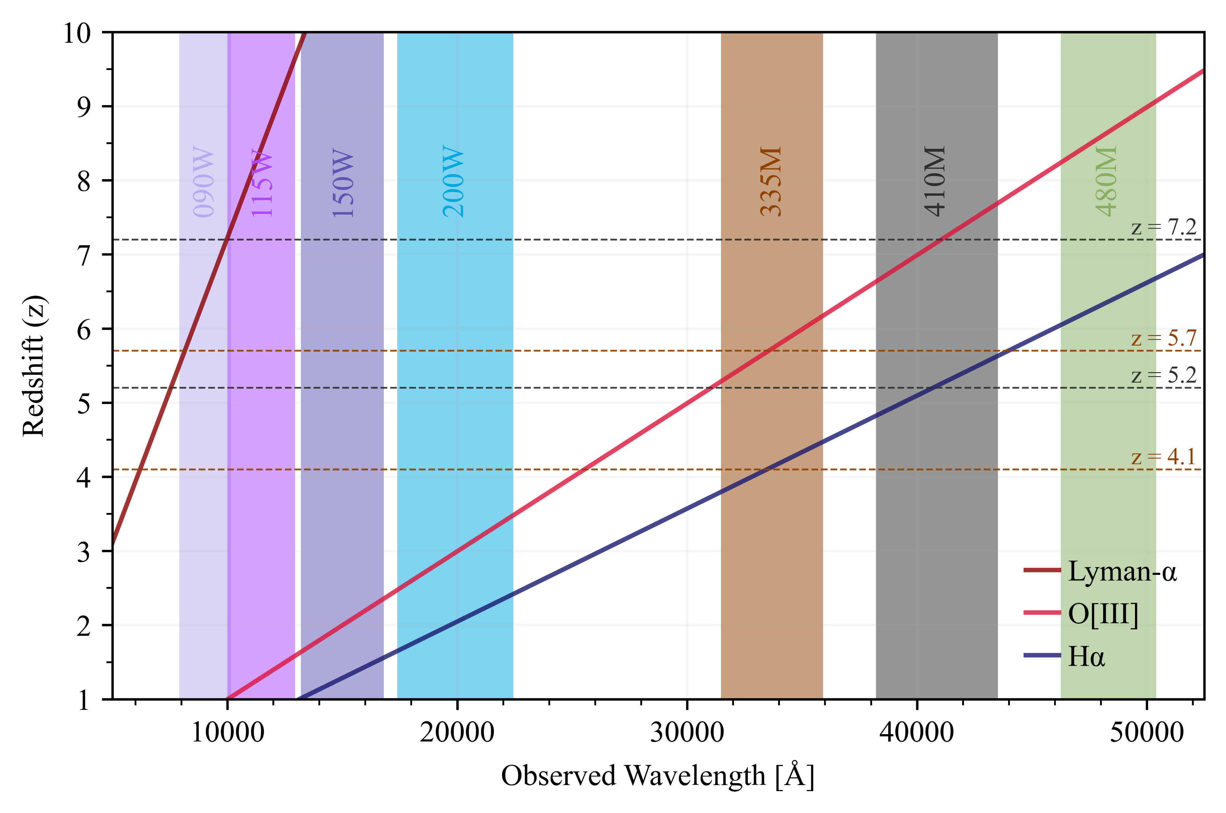
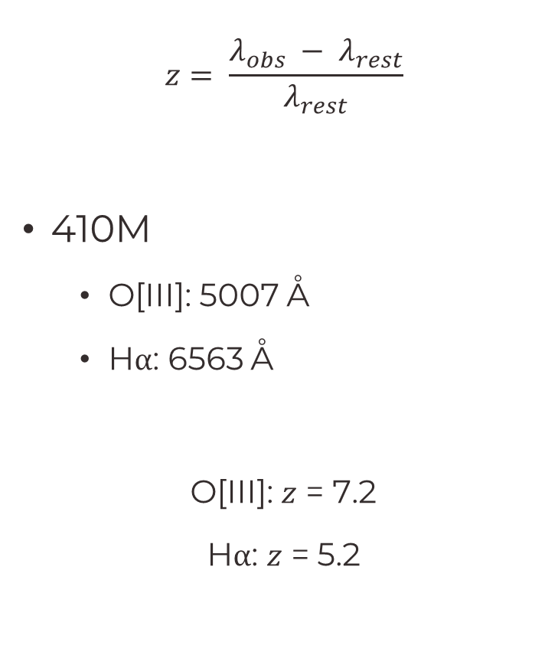
Wavelength - Redshift
$$z= \frac{λ_{obs} − λ_{rest}}{λ_{rest}}$$
410M
O[III]: 5007 Å
Hα: 6563 Å
O[III]: $z$ = 7.2
Hα: $z$ = 5.2
41057 Å
40690 Å

Slide 22
Wavelength - Redshift
Notes:
The analysis is done in the 410M filter

Slide 23
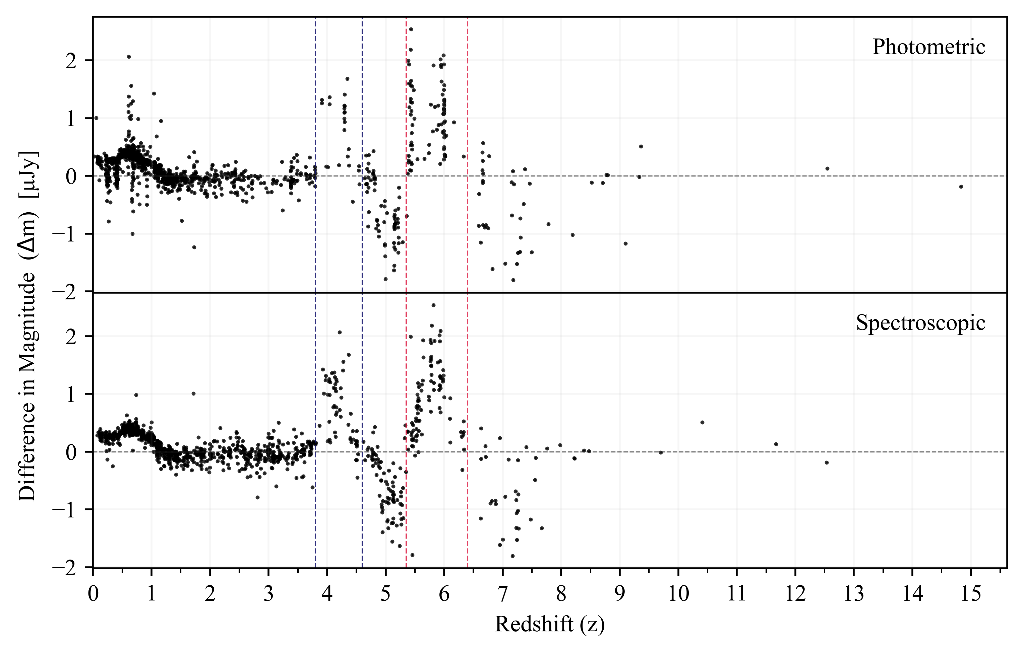
Equivalent Widths (EW)
Notes:
Lines here are for the “Continuum” filter
No absorption features
Straight lines of source - Redshift focusing
That is due to the fitting with the Photometric Redshift software
Could be adjusted with zeropoints
Redshift range that it was set to vary
Or templates that were used
Now, With this
we can get EW
Using an integral
To look at the area under the emission

Slide 24
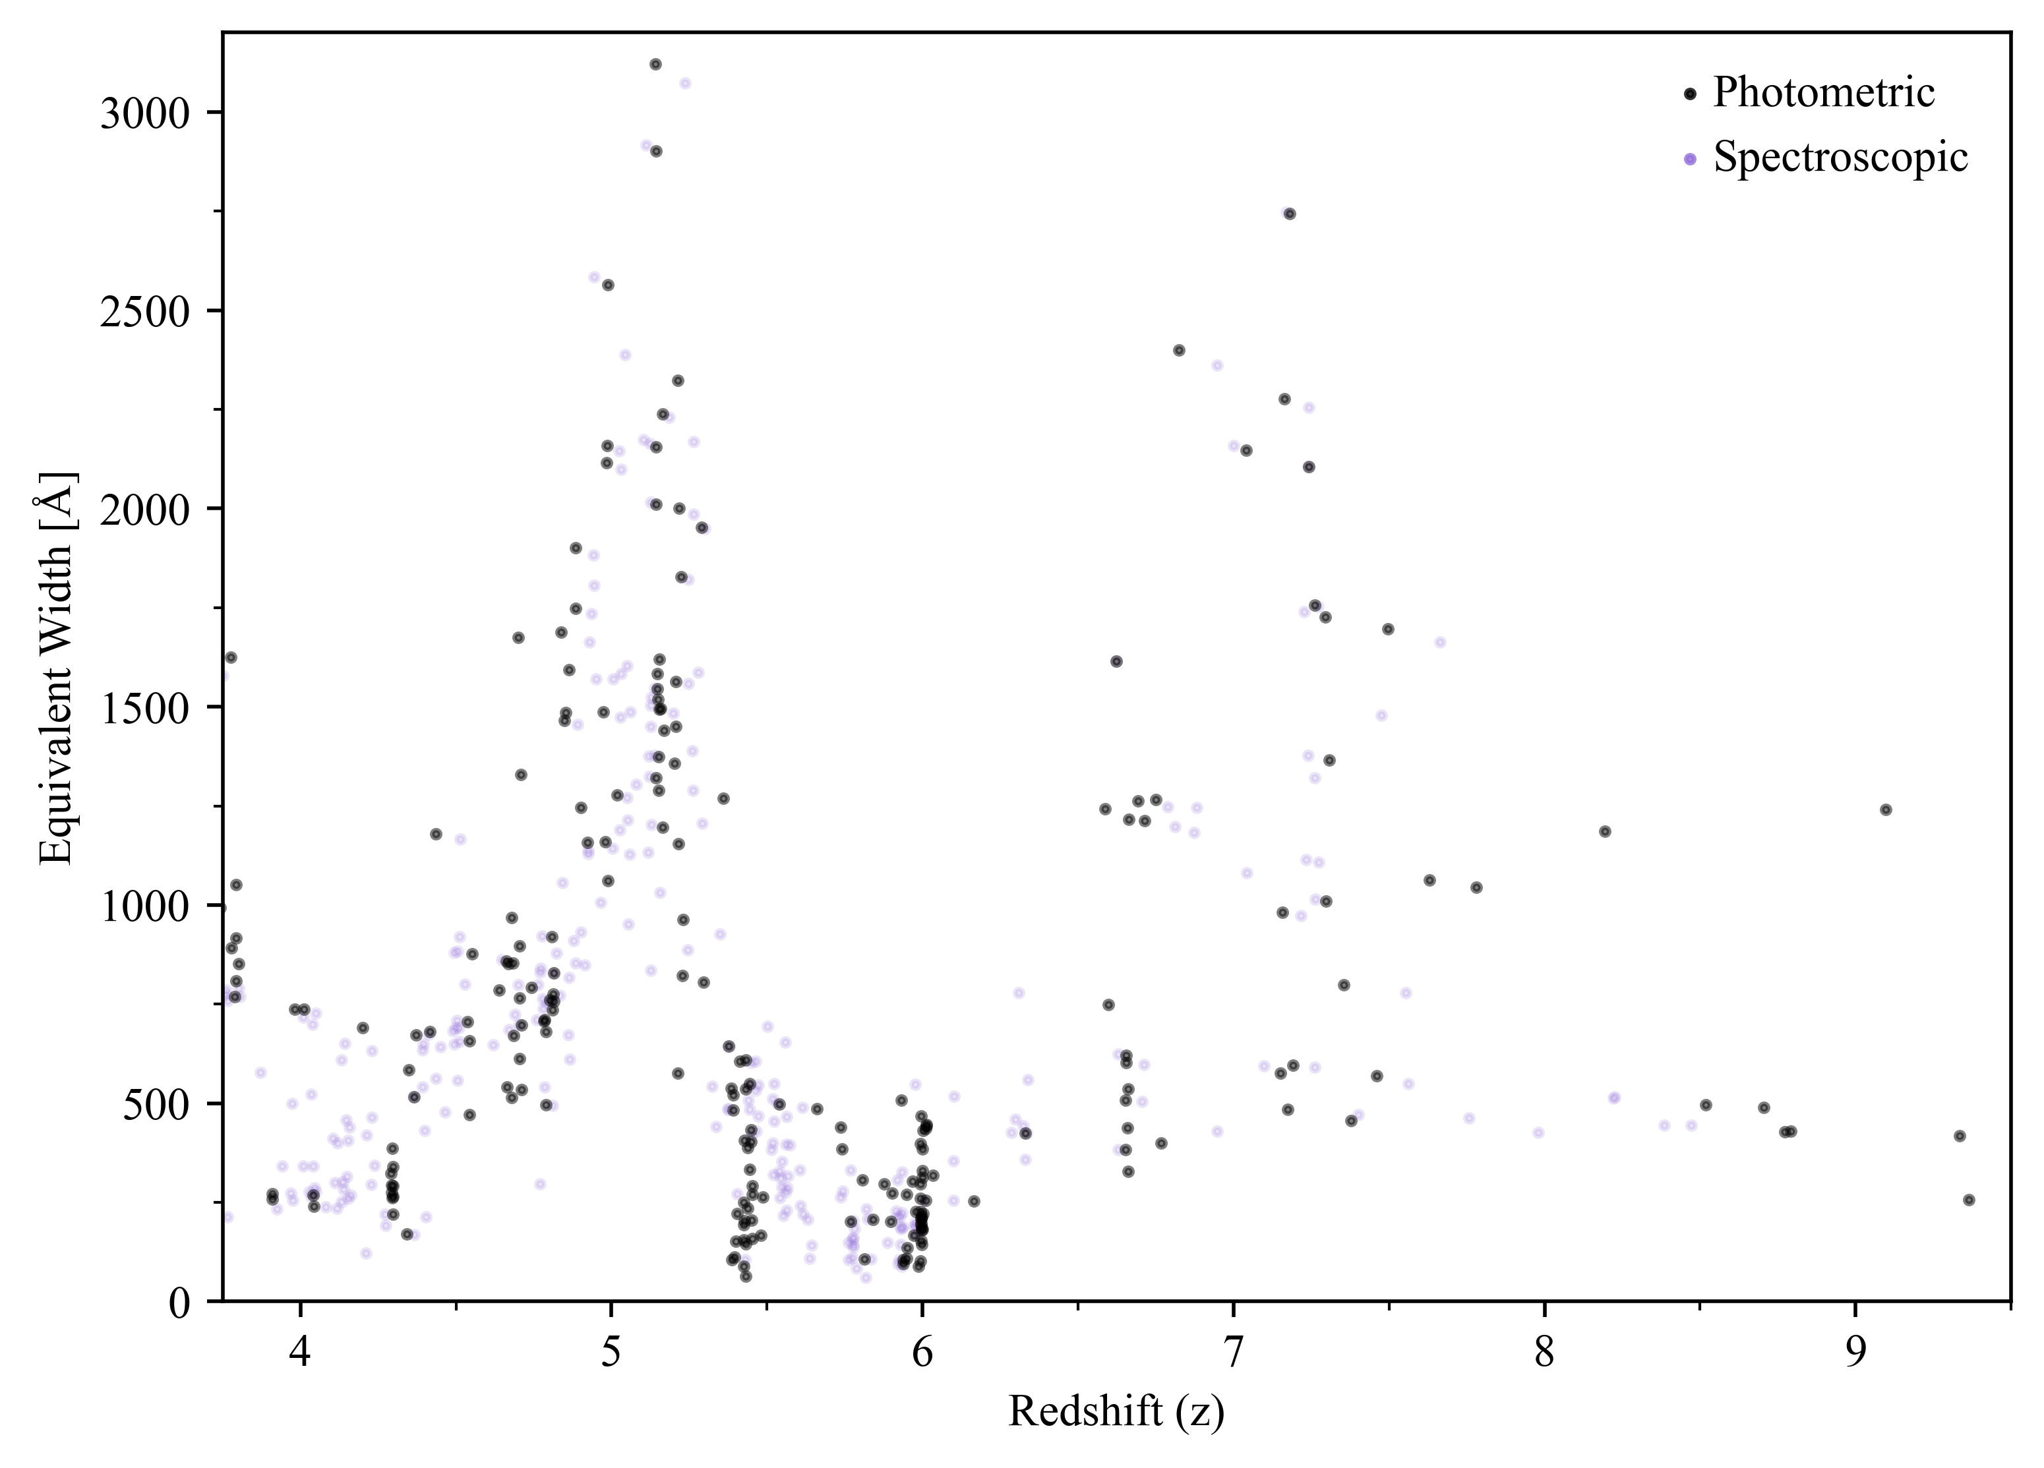
Equivalent Widths (EW)
Using an Integral
EWs are found
Place Cuts at:
z ~ 5: Hα
z ~ 7: O[III]
Notes:
Using an integral:
Got the EWs
Cuts are placed
To isolate objects
At z=5 and 7

Slide 25
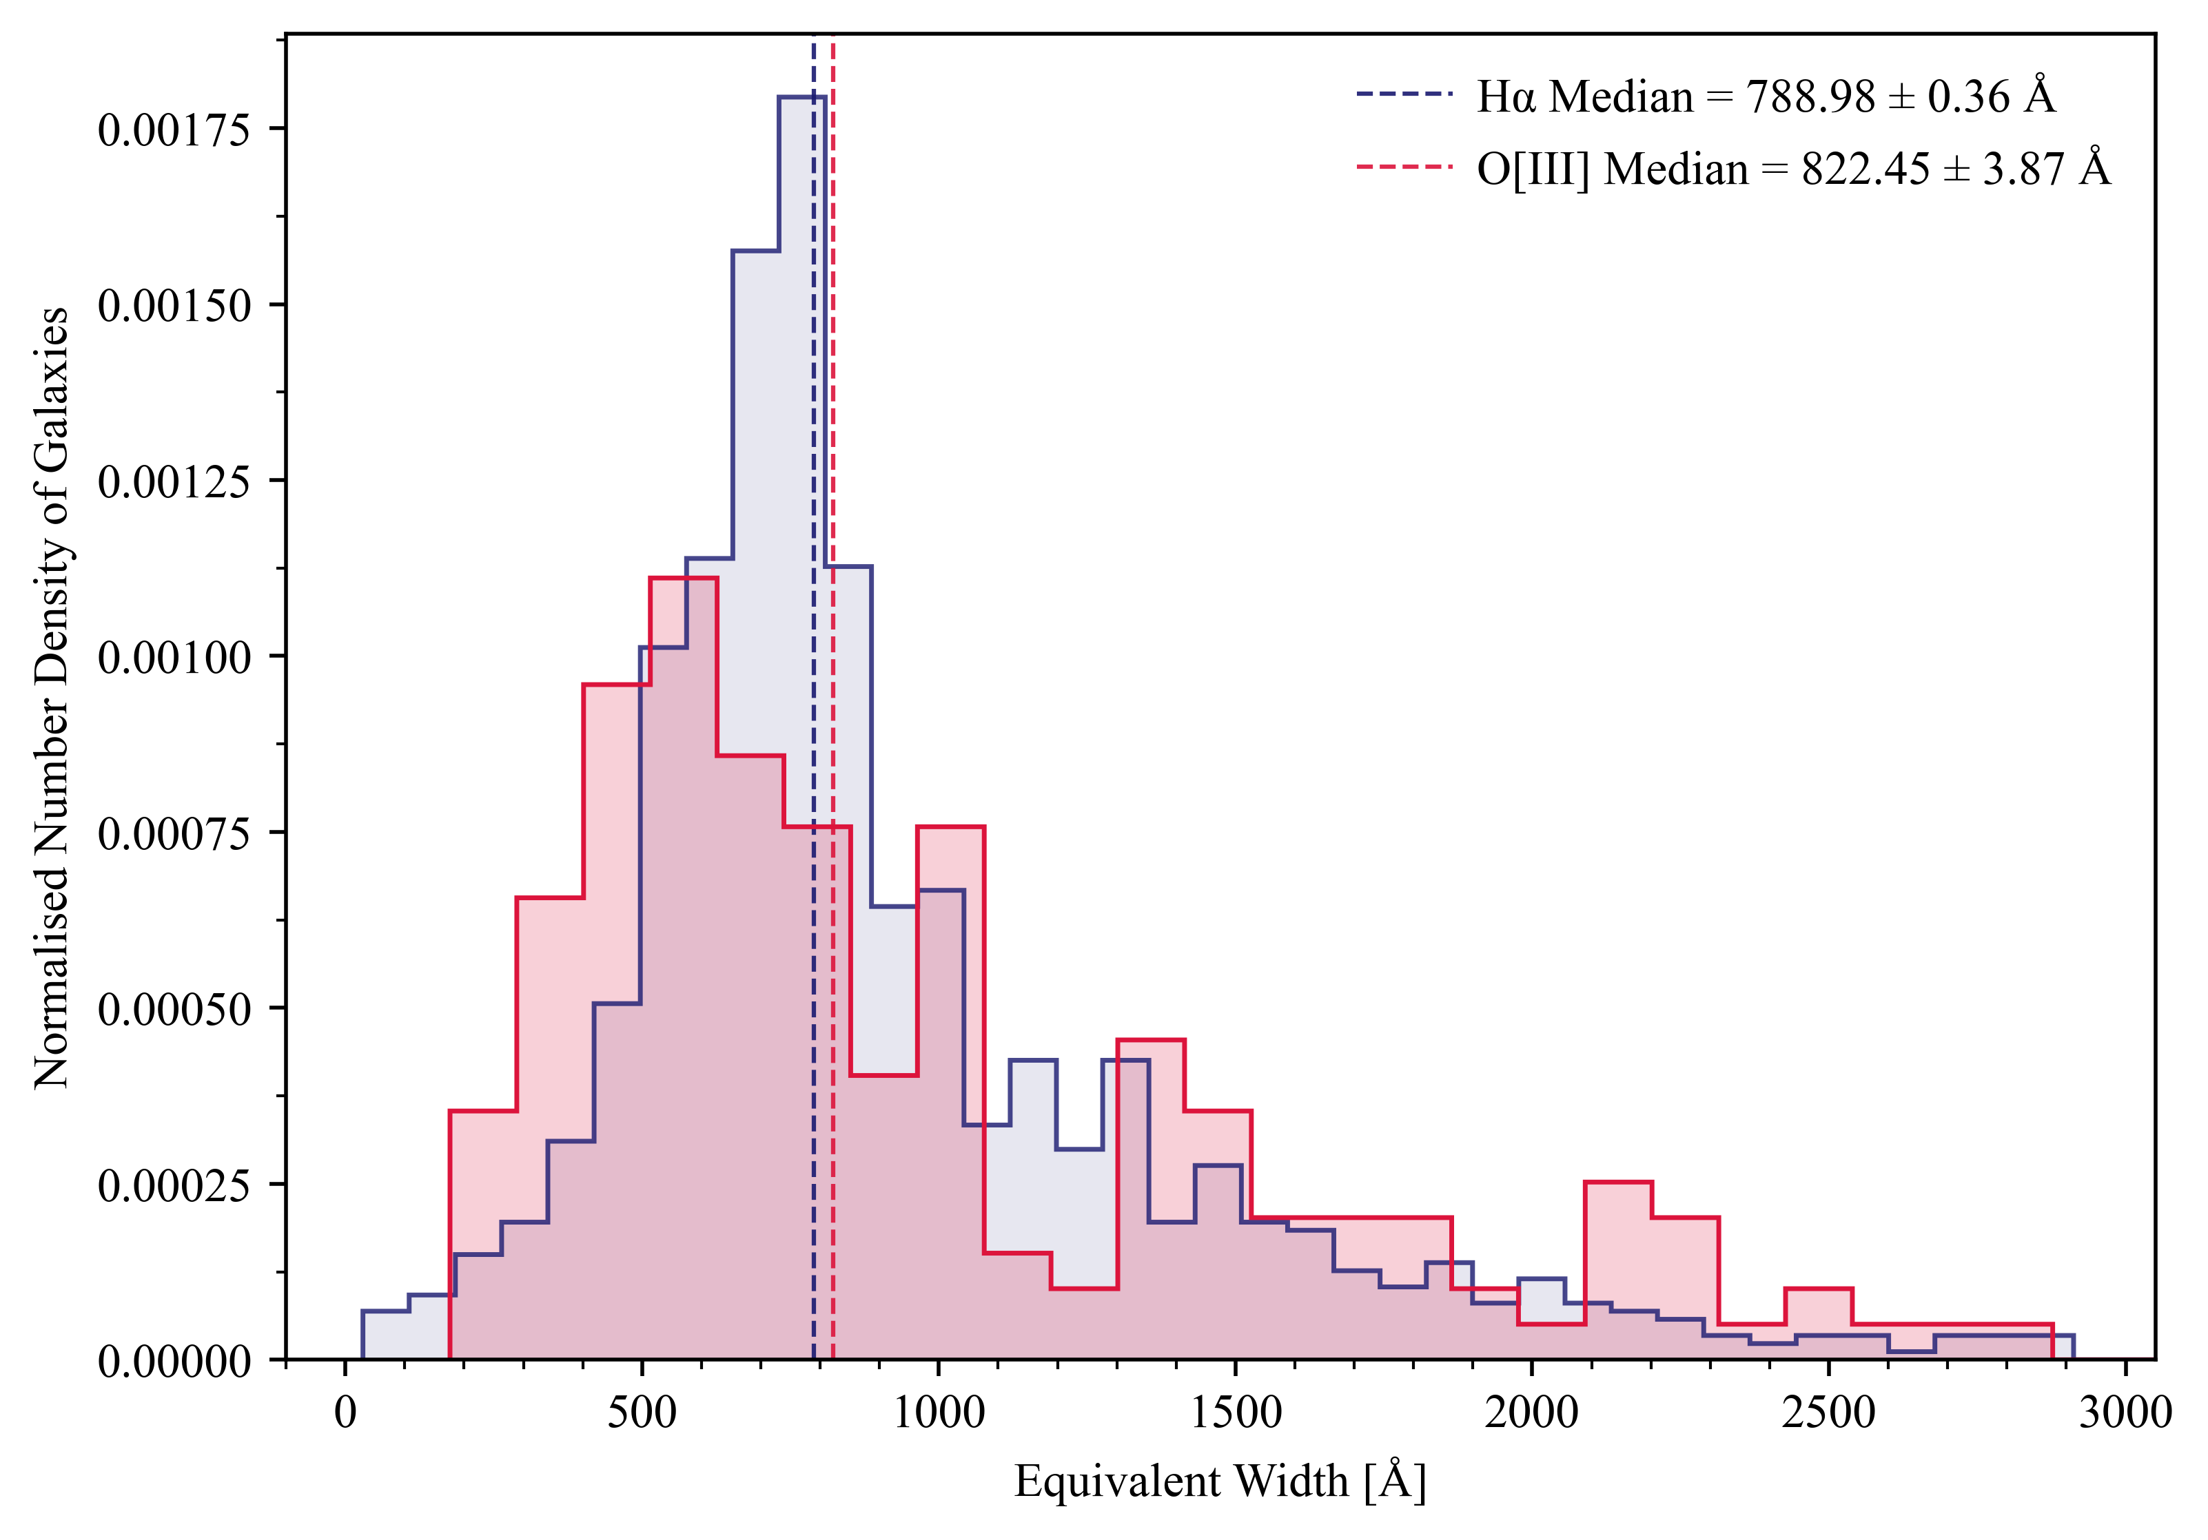
Notes:
For the same distribution of sources,
Histogram of the EWs
There are fewer sources for O[III]
Because we are looking at a higher redshift range
Harder to detect faint sources
But given difference in sample size
The medians are the similar - 800 Å
These galaxies are extreme emission line emitters
These are galaxies that have EWs > 100 Å

Slide 26
Photon Production Efficiency
The relationship used here was done for a sample at lower redshift (z ≈ 1.3 − 2.4) in.

Slide 27
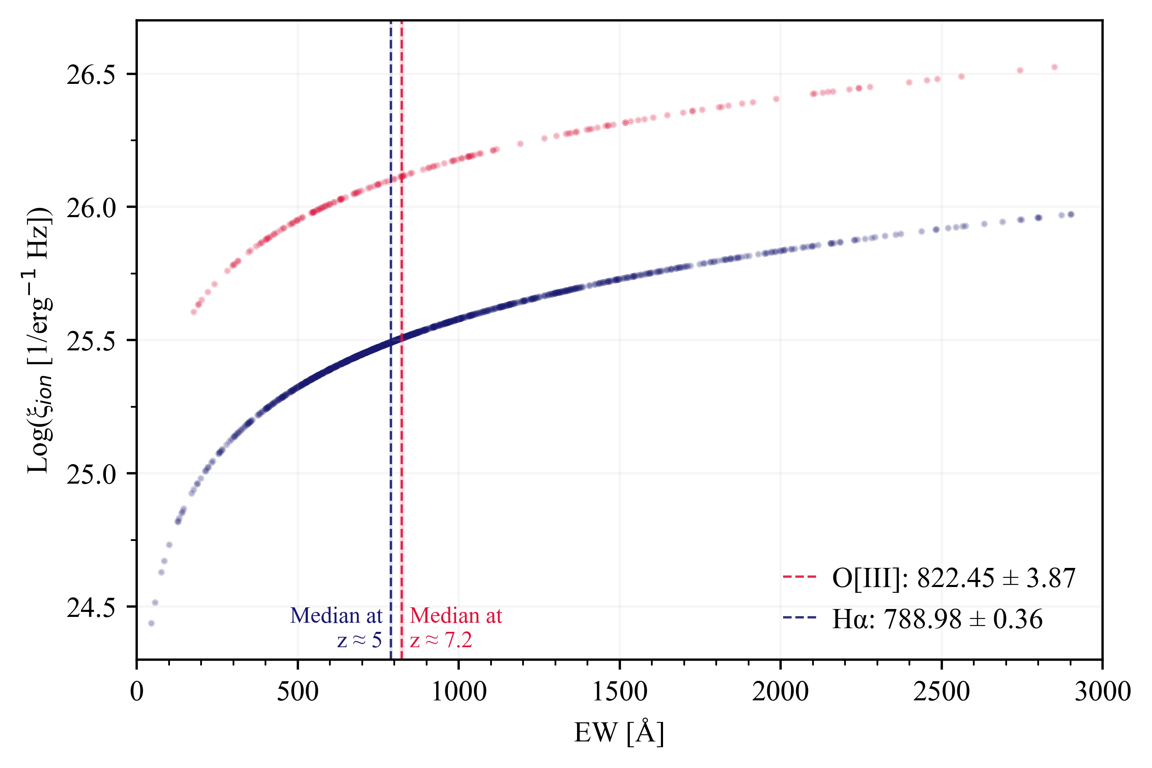
Medians
Literature:
(Tang et al. 2019)
25.58 erg⁻¹ Hz
This work:
25.8 erg⁻¹ Hz
Ionised Photon Production Efficiency
Notes:
Ionised Photon Production Efficiency
Found with relationship from a paper
Focused on the not-so-distant universe
Y-axis is shown in Log scale
Actually a linear increase
As the EW increases, efficiency rate increases.
Natural result
Photons are being ionised
Due to processes that create H-alpha and O[III]
These median compare to literature values well
The findings demonstrate that the same physical mechanics that drive stellar formation in galaxies is largely similar to those galaxies in the not-so-distant nearby universe (z ≈ 1.3 − 2.4).

Slide 28
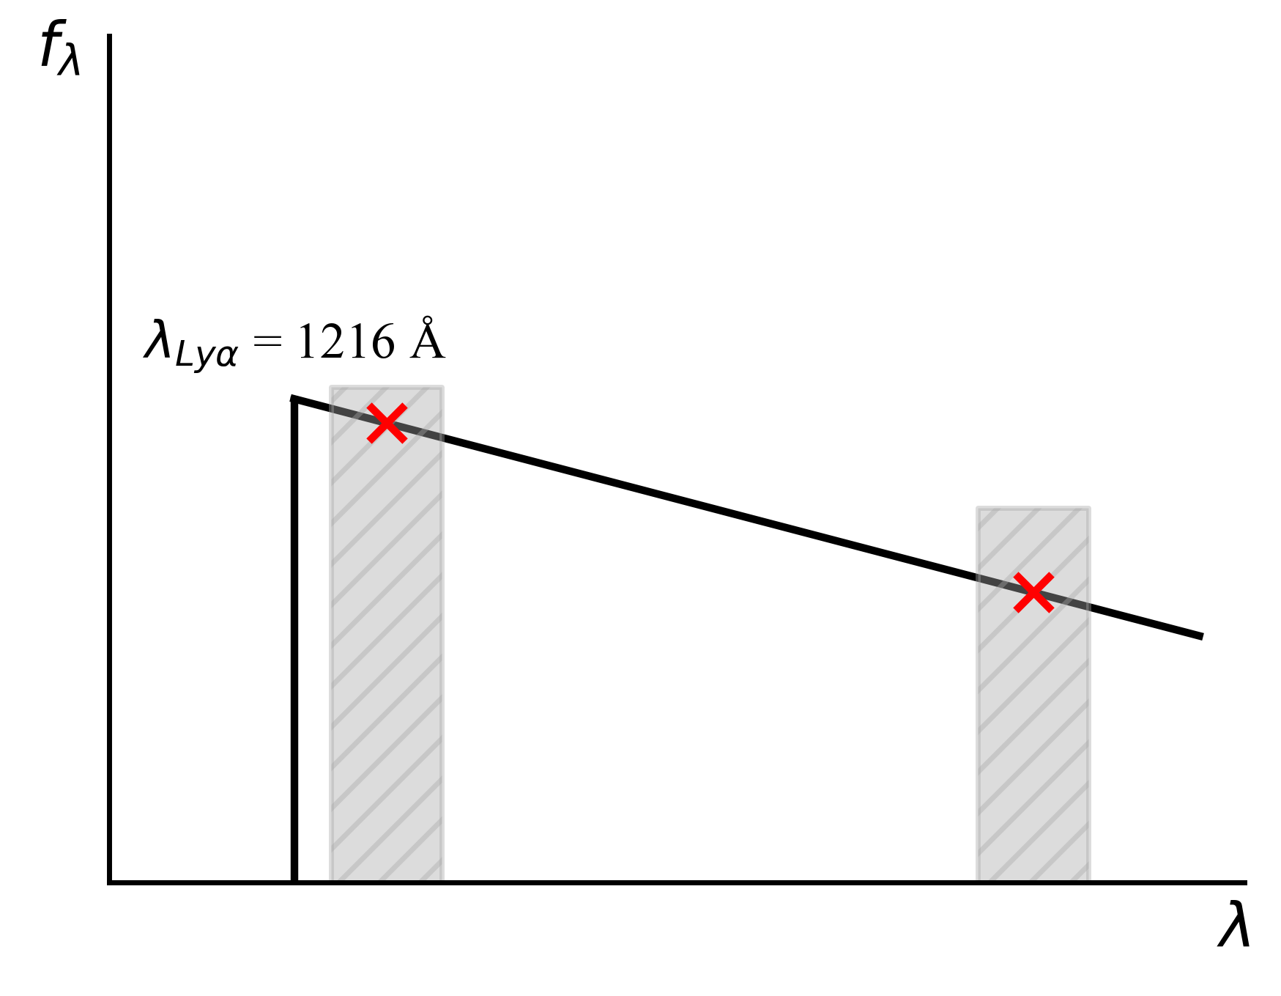
UV Spectral Slope
Done by extrapolating
Flux in 2 filters from the catalogue
Find the gradient of the slope between the 2 points
Expect: β ~ -2
Notes:
UV spectral Slope
Found by extrapolating the flux
In 2 distinct filters from the catalogue
Find the slope between the 2 points
Expected to be at β ~ -2

Slide 29
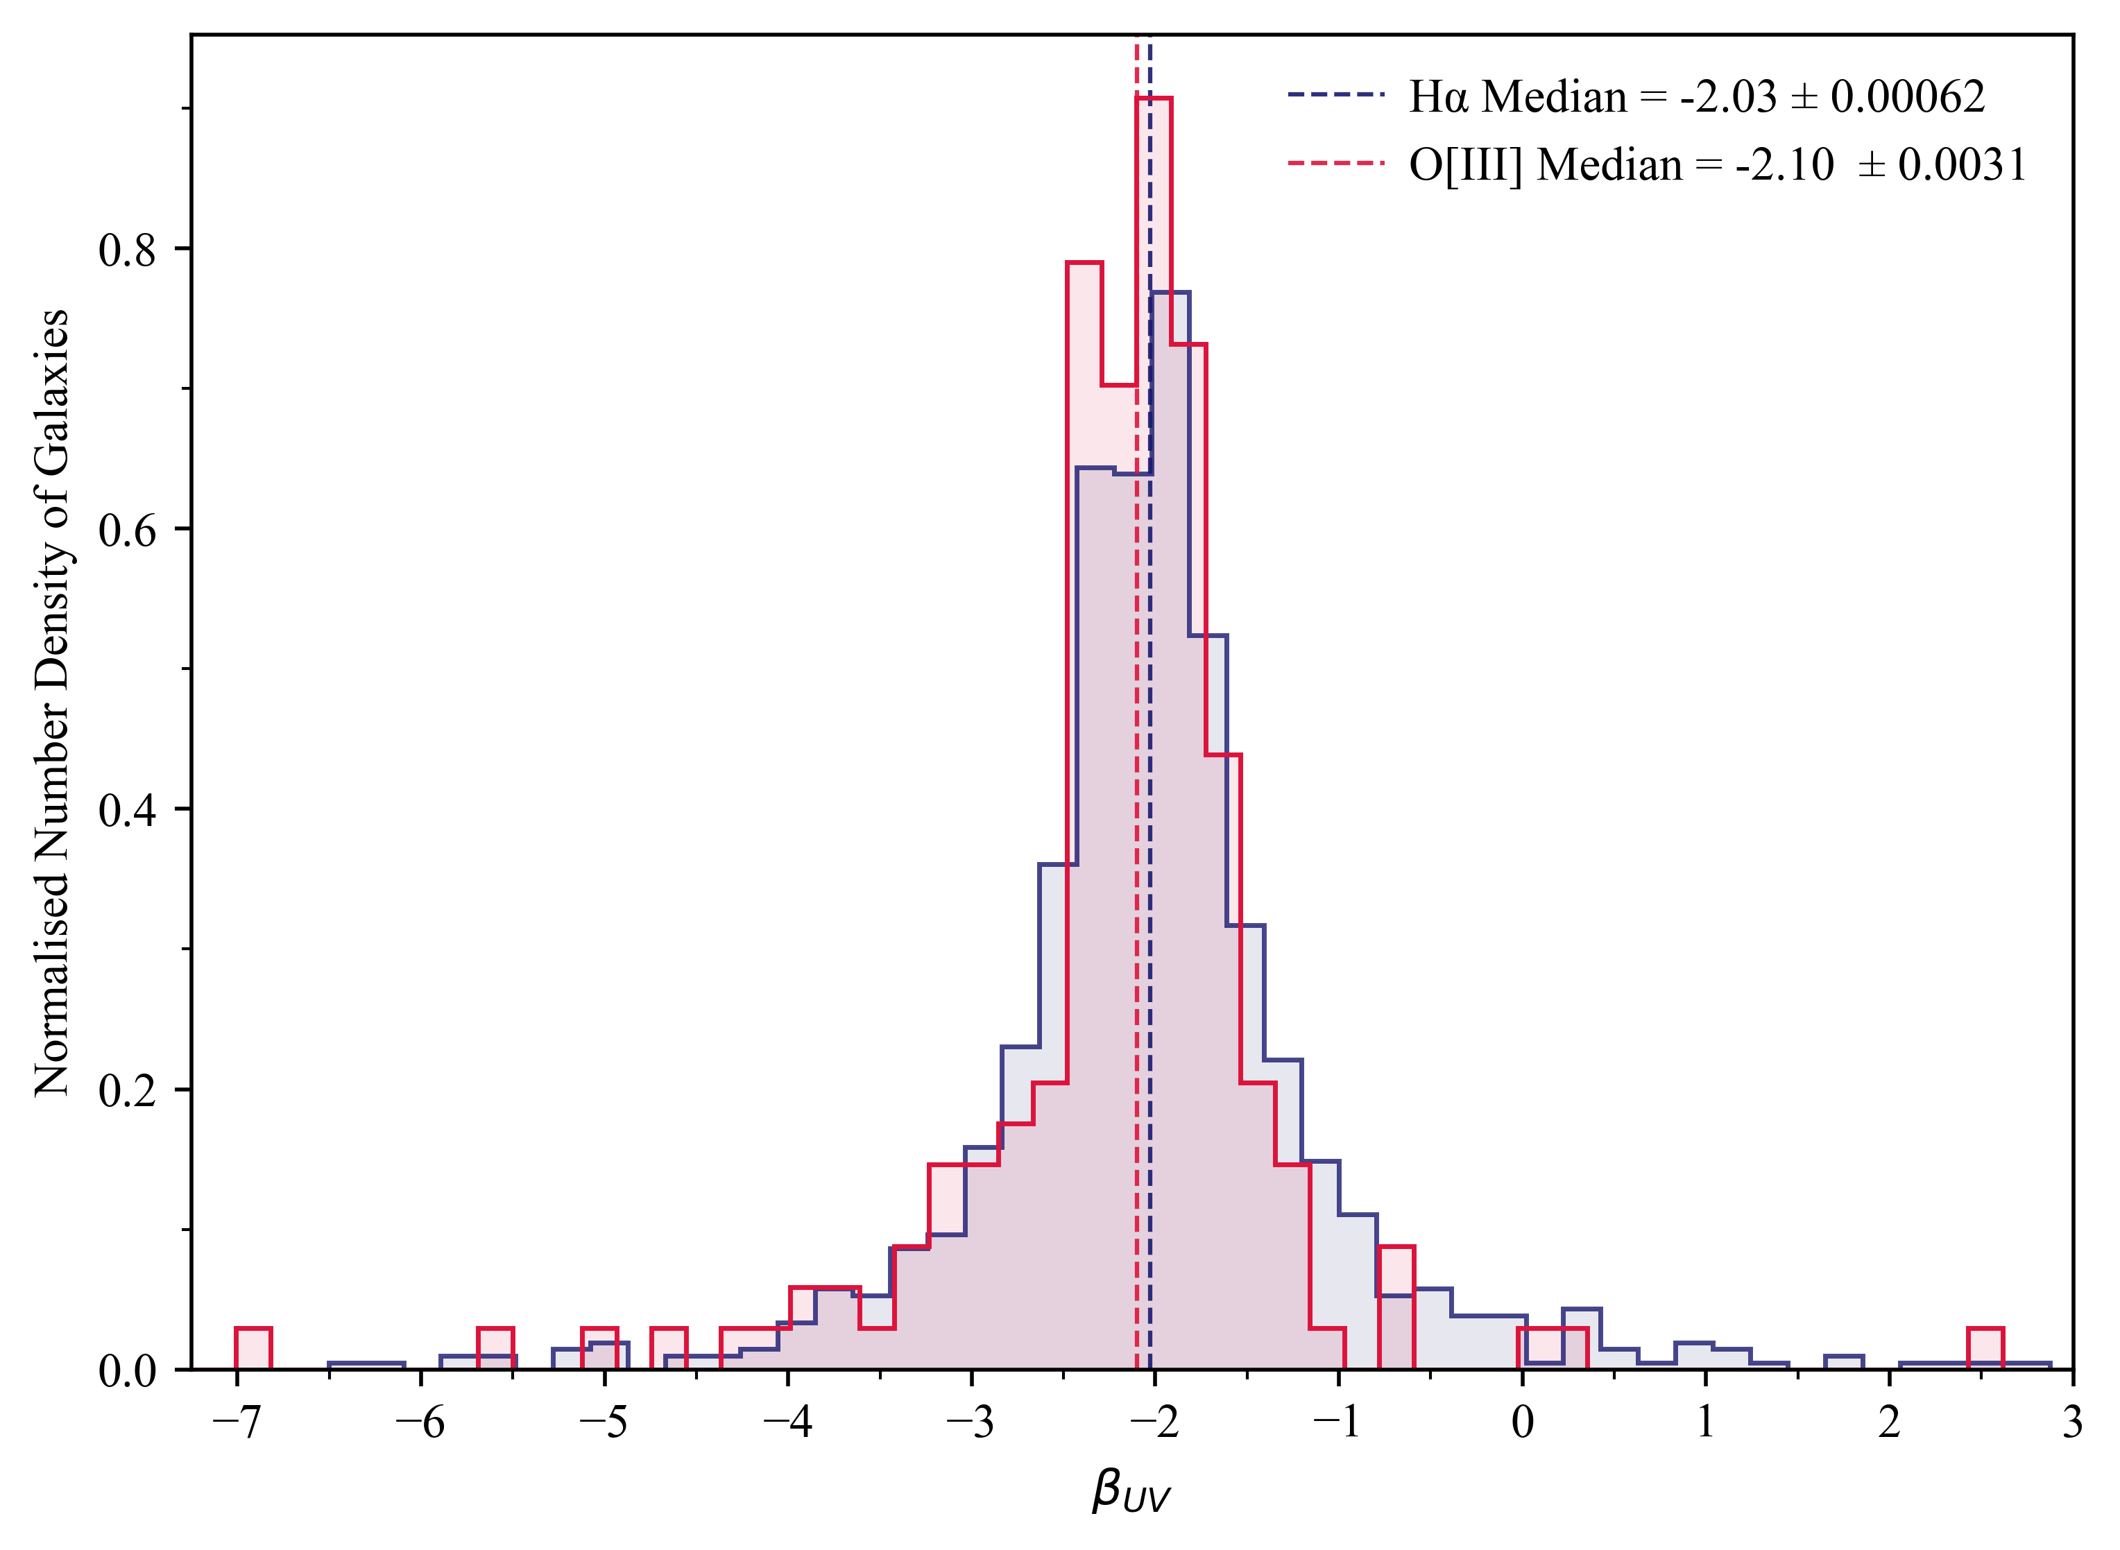
Notes:
2 things to take away:
High number of sources at -2
Good sign
Some sources that are Leftward - red
Comparatively more dust present in these galaxies

Slide 30
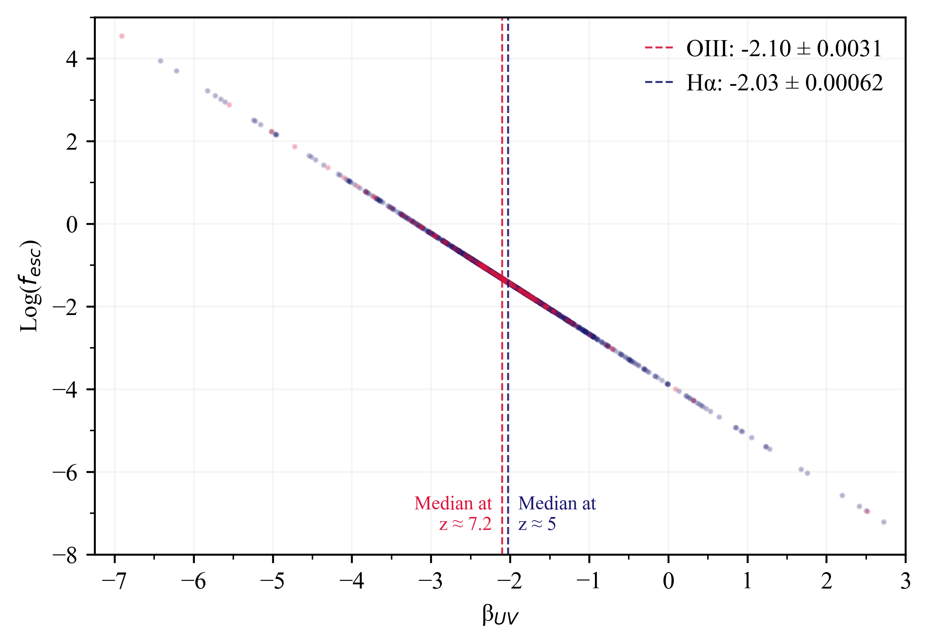
Notes:
This is a logarithmic distribution:
A higher number of photons are allowed to escape
As the spectral slope becomes more and more negative
when the galaxy’s spectrum is redder in comparison.

Slide 31
Conclusion
From the data,
Catalogue was built
Redshifts were estimated
Sources that were estimated to be in the Epoch of Comic Reionisation were isolated
Properties:
Equivalent Width
UV spectral Slope
Stellar formation is similar to galaxies in the not-so-distant nearby universe

Slide 32
References
NASA, ESA, CSA, M. Zamani (ESA/Webb)
"JWST Advanced Deep Extragalactic Survey (JADES)." Webb Space Telescope, December 09, 2022, https://webbtelescope.org/contents/media/images/01GKT0RRJBP5ZMJRMCQNPT8SXP.?tag=planetary%20rings
R. Cowen. (2013)
“Galaxy formation: Cosmic dawn.” Nature 497. p. 554–556. https://doi.org/10.1038/497554a
Förster Schreiber, N. M. and S. Wuyts. (2020)
“Star-Forming Galaxies at Cosmic Noon”. Review of Astronomy & Astrophysics 58, p. 661–725. https://doi.org/10.1146/annurev-astro-032620-021910
Rieke, J. et al. (2023)
“JADES Initial Data Release for the Hubble Ultra Deep Field: Revealing the Faint Infrared Sky with Deep JWST NIRCam Imaging”. The Astrophysical Journal Supplement Series 269(16), p. 16. https://doi.org/10.3847/1538-4365/acf44d
EAzY:
gbrammer/eazy-py: Pythonic photometric redshift tools based on EAZY (github.com)
Brammer, G. B., van Dokkum, P. G., and Coppi, P. (2008) “EAZY: A Fast, Public Photometric Redshift Code”. The Astrophysical Journal 686(2) IOP. p. 1503–1513. https://doi.org/10.1086/591786
Tang et al. (2019):
“MMT/MMIRS spectroscopy of z = 1.3 - 2.4 extreme [O III] emitters: implications for galaxies in the reionization era”. In: Monthly Notices of the Royal Astronomical Society 489(2) , p. 2572–2594. https://doi.org/10.1093/mnras/stz2236

